Slide 1

PCA for Visualization via SVD
Extracting hidden structures from high-dimensional data

Slide 2


Problem: The Curse of Dimensionality
Data Sparsity Issues
As dimensionality increases, the "volume" of space grows exponentially, making available data points increasingly sparse.
Points are located far apart in high-D space
Distance metrics lose their meaning
Patterns become "invisible" to standard tools

Slide 3
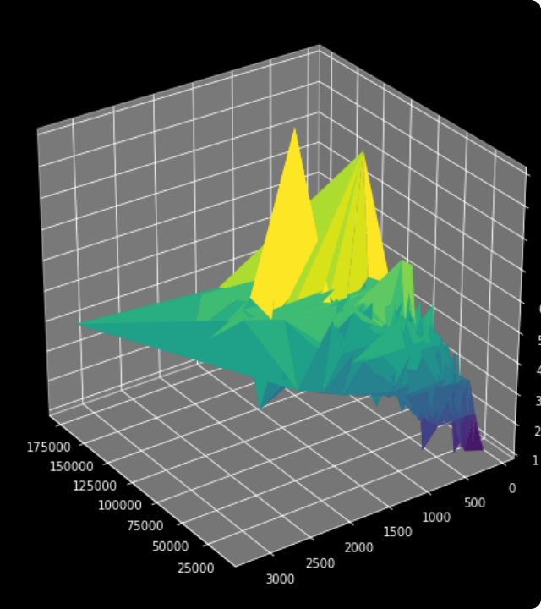
Cognitive Limits
The Visualization Barrier
Human perception is evolutionarily optimized for 3 dimensions. Modern datasets often contain hundreds or thousands of features (dimensions).
Cannot plot 10D data on a screen
Relationships remain hidden in high-D
Critical need: Reduce dimensions while keeping the "Signal"

Slide 4
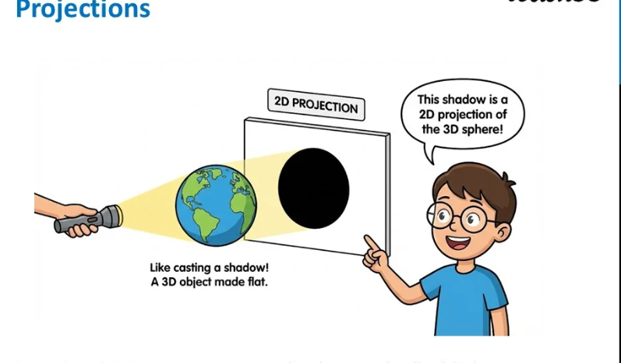
The Solution: Dimensionality Reduction
The Shadow Analogy
Just as a 3D object casts a 2D shadow that retains its core shape, PCA projects high-D data onto a lower-dimensional subspace.
Compress features into "Principal Components"
Flatten the data onto the most informative plane
PC1 and PC2 become your X and Y axes

Slide 5
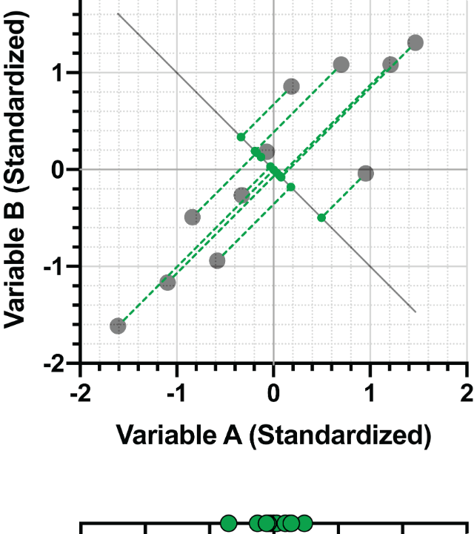
Strategy: Maximize Variance
Capturing the Signal
PCA identifies the axes along which the data varies the most. These axes (Principal Components) capture the maximum "information" or "spread".
PC1: Direction of largest spread
PC2: Second largest spread (orthogonal)
High variance = High Information content

Slide 6

Goal: Minimize Reconstruction Error
Preserving Data Integrity
While reducing dimensions, PCA ensures the projected points are as close to the original points as possible.
"The best projection is the one where the original data points are least disturbed."
Minimizes the "distance" lost during projection
Retains global structure of clusters
Naturally filters out low-variance "Noise"

Slide 7



The Engine: Singular Value Decomposition
Matrix Factorization
SVD decomposes any data matrix X into three unique matrices that reveal the underlying geometric structure.
Where V contains the Principal Components.

Slide 8
Advantage: Numerical Stability
Avoid the Covariance Matrix
Traditional PCA requires computing the covariance matrix XᵀX, which can lead to significant precision loss due to "squaring" the data.
SVD works directly on X
Higher precision for small variations
Handles "ill-conditioned" matrices robustly

Slide 9
Advantage: Computational Efficiency
Scalability for Big Data
Modern implementations use Truncated SVD, which computes only the top k components needed for visualization.
Significantly faster for large datasets
Lower memory footprint (no XᵀX storage)
Industry standard in Scikit-Learn & NumPy

Slide 10

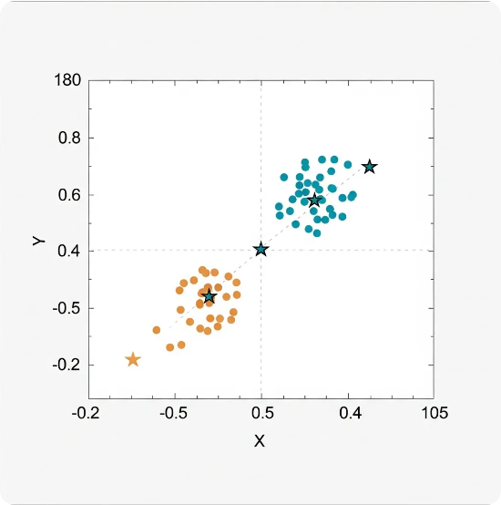
Conclusion: From Math to Insight
Final Takeaways
By leveraging SVD, PCA provides a robust and efficient way to map complex data into a visual subspace.
Unveils hidden patterns and clusters
Mitigates the Curse of Dimensionality
Foundation for exploratory data analysis

Slide 11






Image Sources
https://datasciencedojo.com/wp-content/uploads/2025/10/Image_fx64-4.jpg
Source: datasciencedojo.com
https://miro.medium.com/v2/resize:fit:1032/1*yjIZYS_mBOt8xOc3ROxKLQ.png
Source: medium.com
https://cdn.teachoo.com/b305798f-6c92-4539-9dd0-c252d88ede5e/slide19.jpg
Source: www.teachoo.com
https://www.graphpad.com/guides/prism/latest/statistics/images/hmfile_hash_d1fa5d0a.png
Source: www.graphpad.com
https://miro.medium.com/v2/resize:fit:1400/1*ktLbtPeMY-7xkpBLve3BXQ.png
Source: pub.towardsai.net
https://upload.wikimedia.org/wikipedia/commons/thumb/4/4c/30_St_Mary_Axe_from_Leadenhall_Street.jpg/330px-30_St_Mary_Axe_from_Leadenhall_Street.jpg
Source: en.wikipedia.org

Slide 12


Image Sources
https://upload.wikimedia.org/wikipedia/commons/thumb/d/d3/IBM_Blue_Gene_P_supercomputer.jpg/1280px-IBM_Blue_Gene_P_supercomputer.jpg
Source: en.wikipedia.org
https://inkly.cloud/wp-content/uploads/2026/01/2d-scatter-plot-showing-three-distinct-data-cluste-1768878055612.webp
Source: inkly.cloud

